Slide 1
EENG 284 Lab 3
Rock, Paper, Scissors
Notes:
Usually the <title of the lab> is what will be called the “System” through the rest of this document

Slide 2
Lab Objectives
The objective of this lab is to use the concepts learned to build a digital system to play a game of rock, paper, scissors.
Learn how to instantiate objects
Learn hierarchical design

Slide 3
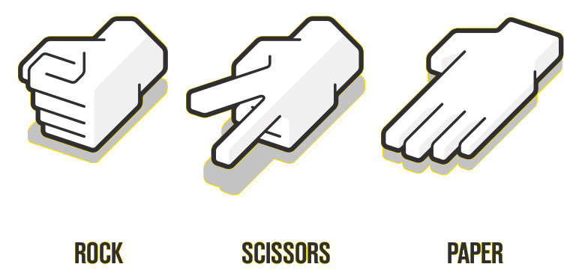
Rock Paper Scissors – the game
Each play makes a throw
Rock beats Scissor
Scissors beat Paper
Paper beats Rock
Notes:
Replace <System> with the name of the

Slide 4
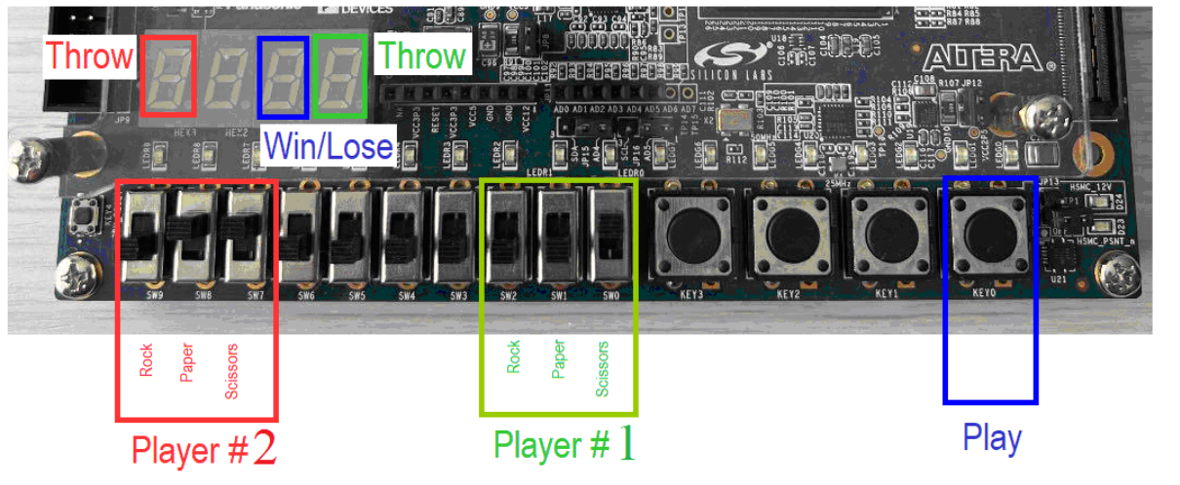
Input, Output Behavior
Input
Each player slides 1 switch (one’s hot)
Then press Play button
Output
Throw 7-segment shows play
Win/Loose shows who won
Notes:
Replace <System> with the name of the

Slide 5
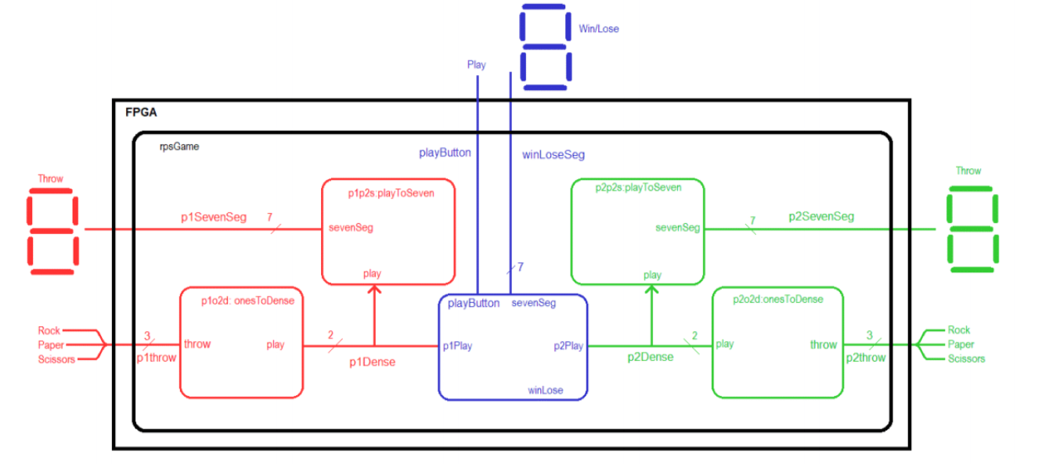
System architecture
Notes:
Talk about the input is transformed into the output using the system architecture

Slide 6
oneToDense Module
Input: 3-bit vector Rock, Paper or Scissors
Output: 2-bit vector
One’s-hot code
Exactly 1 bit is equal to logic 1, all others 0
“Hot” bit is logic 1
N-bit string has N one’s-hot codes
Dense code
Every combination of bits has a meaning

Slide 7
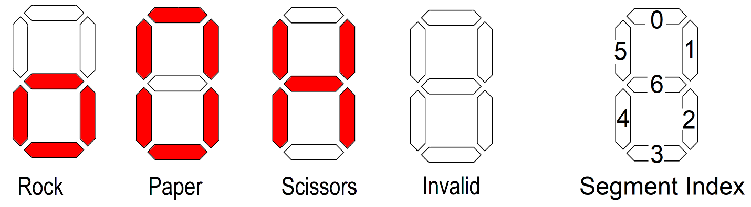
playToSevenSeg Module
Input: 2-bit dense code of play
Output 7-bit seven segment showing play

Slide 8
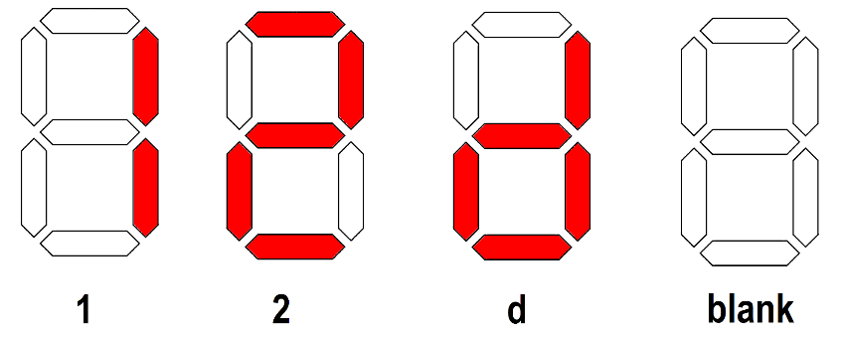
winLose Module
Input: 2-bit dense code of play from each player
button
Output 7-bit seven segment showing game outcome

Slide 9
rpsGame Module
Input: 3-bit one’s-hot code of play from each player
button
Output 7-bit seven segment showing each player’s play
7-bit seven segment showing game outcome

Slide 10
Simulation
No Simulation this week
Unusual

Slide 11
Synthesis
Use the Cyclone V GX User Guide to find
Seven Segment
Player 1 and Player 2 Throw
Win Loose
Button
Play
Slide Switch
Player 1 and Player 2 Throw

Slide 12
Deliverables
onesToDense Module:
Complete Table 2 truth table for oneToDense module
Canonical SOP expressions for the play[1] and play[0] functions
Verilog code for the entire module (courier 8-point font single spaced), leave out header comments.
playToSeven Module:
Complete Table 3
Verilog code for the module (courier 8-point font single spaced), leave out header comments.
winLose Module:
Complete Table 4 truth table for winLose module
Verilog code for the module (courier 8-point font single spaced) , leave out header comments.
rpsGame Module:
Verilog code for the module (courier 8-point font single spaced) ,leave out header comments.
Pin Assignment:
Completed pin assignment table for 7-segment, slide switches and button.

